Slide 1
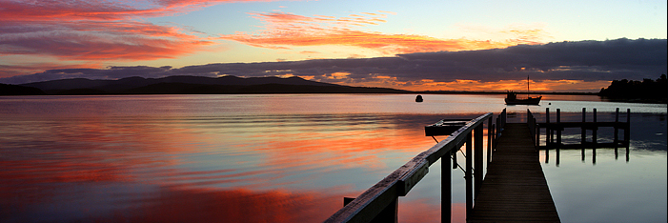
Weather the Weather Who Has Seen the Wind? Part 1 Who has See the Wind? Part 2 Singin’ In the Rain Listen to the Rain Cold Snap I Wandered Lonely As a Cloud Meteor Shower Thunder Part 1 Thunder Part 2 Lightning! Twister Storm Let the Sun Shine Down
Weather the Weather

Slide 2
Weather the Weather
HOME

Slide 3
Whether the weather is sunny and bright, Whether the weather is bleak, Whether conditions are gonna be right, How should we plan for the week?
HOME

Slide 4
Whether the mercury’s up at the top Or falling to twenty below, Whether the temperature’s hot or cold, We’ll weather the weather, we know!
HOME

Slide 5
Some days, it may be sunny. Some days, it may be warm. Some days, it isn’t funny. Some days, it’s gonna storm!
HOME

Slide 6
Whether the weather is mild or severe, The meteorologists say, That whether the weather brings rain or shine, We’ll weather the weather today.
HOME

Slide 7
Weather the weather okay. Weather… the weather… today!
HOME

Slide 8
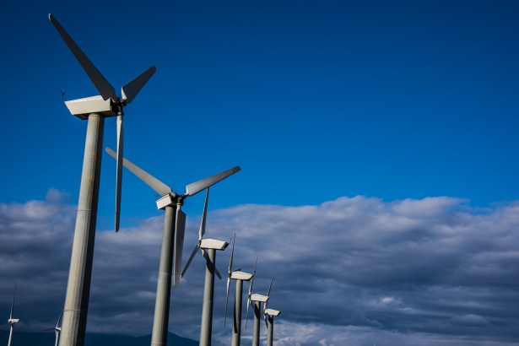
Who Has Seen the Wind? Part 1
HOME

Slide 9
Passing through, The wind is passing through. Passing through, The wind is passing through.
HOME

Slide 10
Who has seen the wind? Neither I nor you; But when the leaves hang trembling, The wind is passing through.
HOME

Slide 11
Who has seen the wind? Neither you nor I; But when the trees bow down their heads, The wind is passing by.
HOME

Slide 12
… And where have you been? Will we feel a gentle breeze When you visit once again?
HOME

Slide 13
Passing through, The wind is passing through. Passing through, The wind is passing through.
HOME

Slide 14
… Who has seen the wind? Who has seen the wind? Who has seen the wind? Neither I nor you.
HOME

Slide 15
Who Has Seen the Wind? Part 2
HOME

Slide 16
Passing through, The wind is passing through. The wind is passing through.
HOME

Slide 17
Who has seen the wind? Neither I nor you; But when the leaves hang trembling, The wind is passing through.
HOME

Slide 18
Oh, who has seen the wind? Who has seen it? When the trees bow down their heads, The wind is passing by.
HOME

Slide 19
Where are you going, … Will we feel a gentle breeze When you visit once again?
HOME

Slide 20
Passing through, The wind is passing through. The wind is passing through.
HOME

Slide 21
Who has seen the wind? Who has seen the wind? … Who has seen the wind? Neither I nor you.
HOME

Slide 22
Singin’ In the Rain
HOME

Slide 23
Doodle doot doo, doodle, Doodle doot doo-dee doodle, 3x’s Doo…
HOME

Slide 24
I’m singin’ in the rain, Just singin’ in the rain. What a glorious feelin’, I’m happy again.
HOME

Slide 25
I’m laughin’ at clouds So dark up above, The sun’s in my heart And I’m ready for love.
HOME

Slide 26
Let the stormy clouds chase Everyone from the place. Come on with the rain, I’ve a smile on my face.
HOME

Slide 27
I’ll walk down the lane With a happy refrain, Just singin’, singin’ in the rain.
HOME

Slide 28
Dancin’ in the rain, I’m dancin’ in the rain. … I’m happy again.
HOME

Slide 29
… I’m singin’ and dancin’ in the rain.
HOME

Slide 30
… (Round) I’m singin’ in the rain, Just singin’ in the rain. What a glorious feelin’, I’m ** happy again.
HOME

Slide 31
I’m laughin’ at clouds So dark up above, The sun’s in my heart And I’m ready for love.
HOME

Slide 32
Let the stormy clouds chase Everyone from the place. Come on with the rain, I’ve a smile on my face.
HOME

Slide 33
I’ll walk down the lane With a happy refrain, Just singin’, just singin’, just singin’, just singin’, In the rain.
HOME

Slide 34
Doodle doot doo, doodle, Doodle doot doo-dee doodle, 3x’s Doo…
HOME

Slide 35
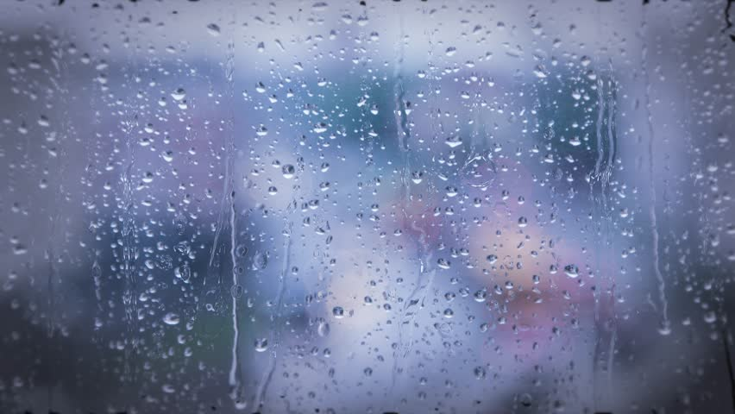
Listen to the Rain
HOME

Slide 36
(Whispered) Listen to the rain. Listen to the rain. … Listen to the rain. Listen to the rain. Listen.
HOME

Slide 37
It’s raining, it’s pouring. Just the sound seems to start my spirit soaring. And the world with its clamor and its clatter Seems to hush with each pitter, pitter-patter.
HOME

Slide 38
It’s raining. Listen to the rain.
HOME

Slide 39
Hear the wind blow. Hear the thunder. Hear my heart beating as I’m filled with wonder. Tiny drops dancing on my window pane know, Without rain, we would never have a rainbow.
HOME

Slide 40
It’s raining. Listen to the rain.
HOME

Slide 41
Drop drop drop drop Drip Drip What a * musical sound! Even robins sing along To the rhythm of the rain.
HOME

Slide 42
Drop drop drop drop Drip Drip Puddles * cover the ground. And the marigolds all are glistening While I’m listening to the rain.
HOME

Slide 43
(Spoken) Now let’s listen, Listen to the rain.
HOME

Slide 44
HOME

Slide 45
It’s raining. Listen to the rain. It’s raining. Listen to the rain. (Whispered) Listen to the rain. Listen to the rain. ** Listen.
HOME

Slide 46
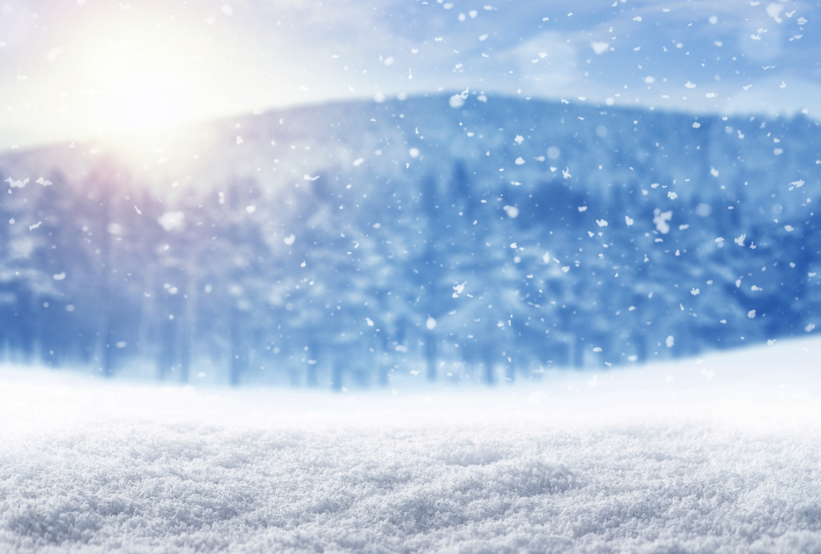
Cold Snap
HOME

Slide 47
New frost is falling and dusting the trees. Snowflakes are forming and lakes start to freeze. Time to wave goodbye to fall. Old Man Winter’s come to call With a cold snap. * ** With a cold snap. * **
HOME

Slide 48
North winds are blowing and chilling the air. Mufflers and mittens are what we all wear. Better go and buy supplies. Now’s the time to winterize For a cold snap. * ** For a cold snap. * **
HOME

Slide 49
Blue lips! Red cheeks! Stuffed nose! Ch-ch-ch-ch-chatt’ring teeth! Sore throat! Can’t speak! Shiver, shudder, ‘tis the season To be coughin’, to be sneezin’!
HOME

Slide 50
…
HOME

Slide 51
Deep snow is drifting and covers the hills, Icicles hanging beneath window sills. Stay inside where it is warm, Safe from nature’s bitter storm And the cold snap. * ** And the cold snap. * **
HOME

Slide 52
And the cold snap. * ** And the cold snap! Brrr!
HOME

Slide 53
I Wandered Lonely As a Cloud
HOME

Slide 54
I wandered lonely as a cloud That floats on high, O’er vales and hills, When all at once I saw a crowd, A host of golden daffodils;
HOME

Slide 55
Beside the lake, Beneath the trees, Fluttering and dancing in the breeze. Fluttering and dancing in the breeze.
HOME

Slide 56
Continuous as the stars that shine, And twinkle on the Milky Way, They stretched in never-ending line, Along the margin of the bay.
HOME

Slide 57
I wandered lonely as a cloud That floats on high, O’er vales and hills, When all at once I saw a crowd of daffodils;
HOME

Slide 58
Ten thousand saw I at a glance, Tossing their heads in sprightly dance,
HOME

Slide 59
I wandered lonely as a cloud, I wandered lonely as a cloud, I wandered lonely as a cloud, A cloud, Lonely as a cloud. A cloud.
HOME

Slide 60
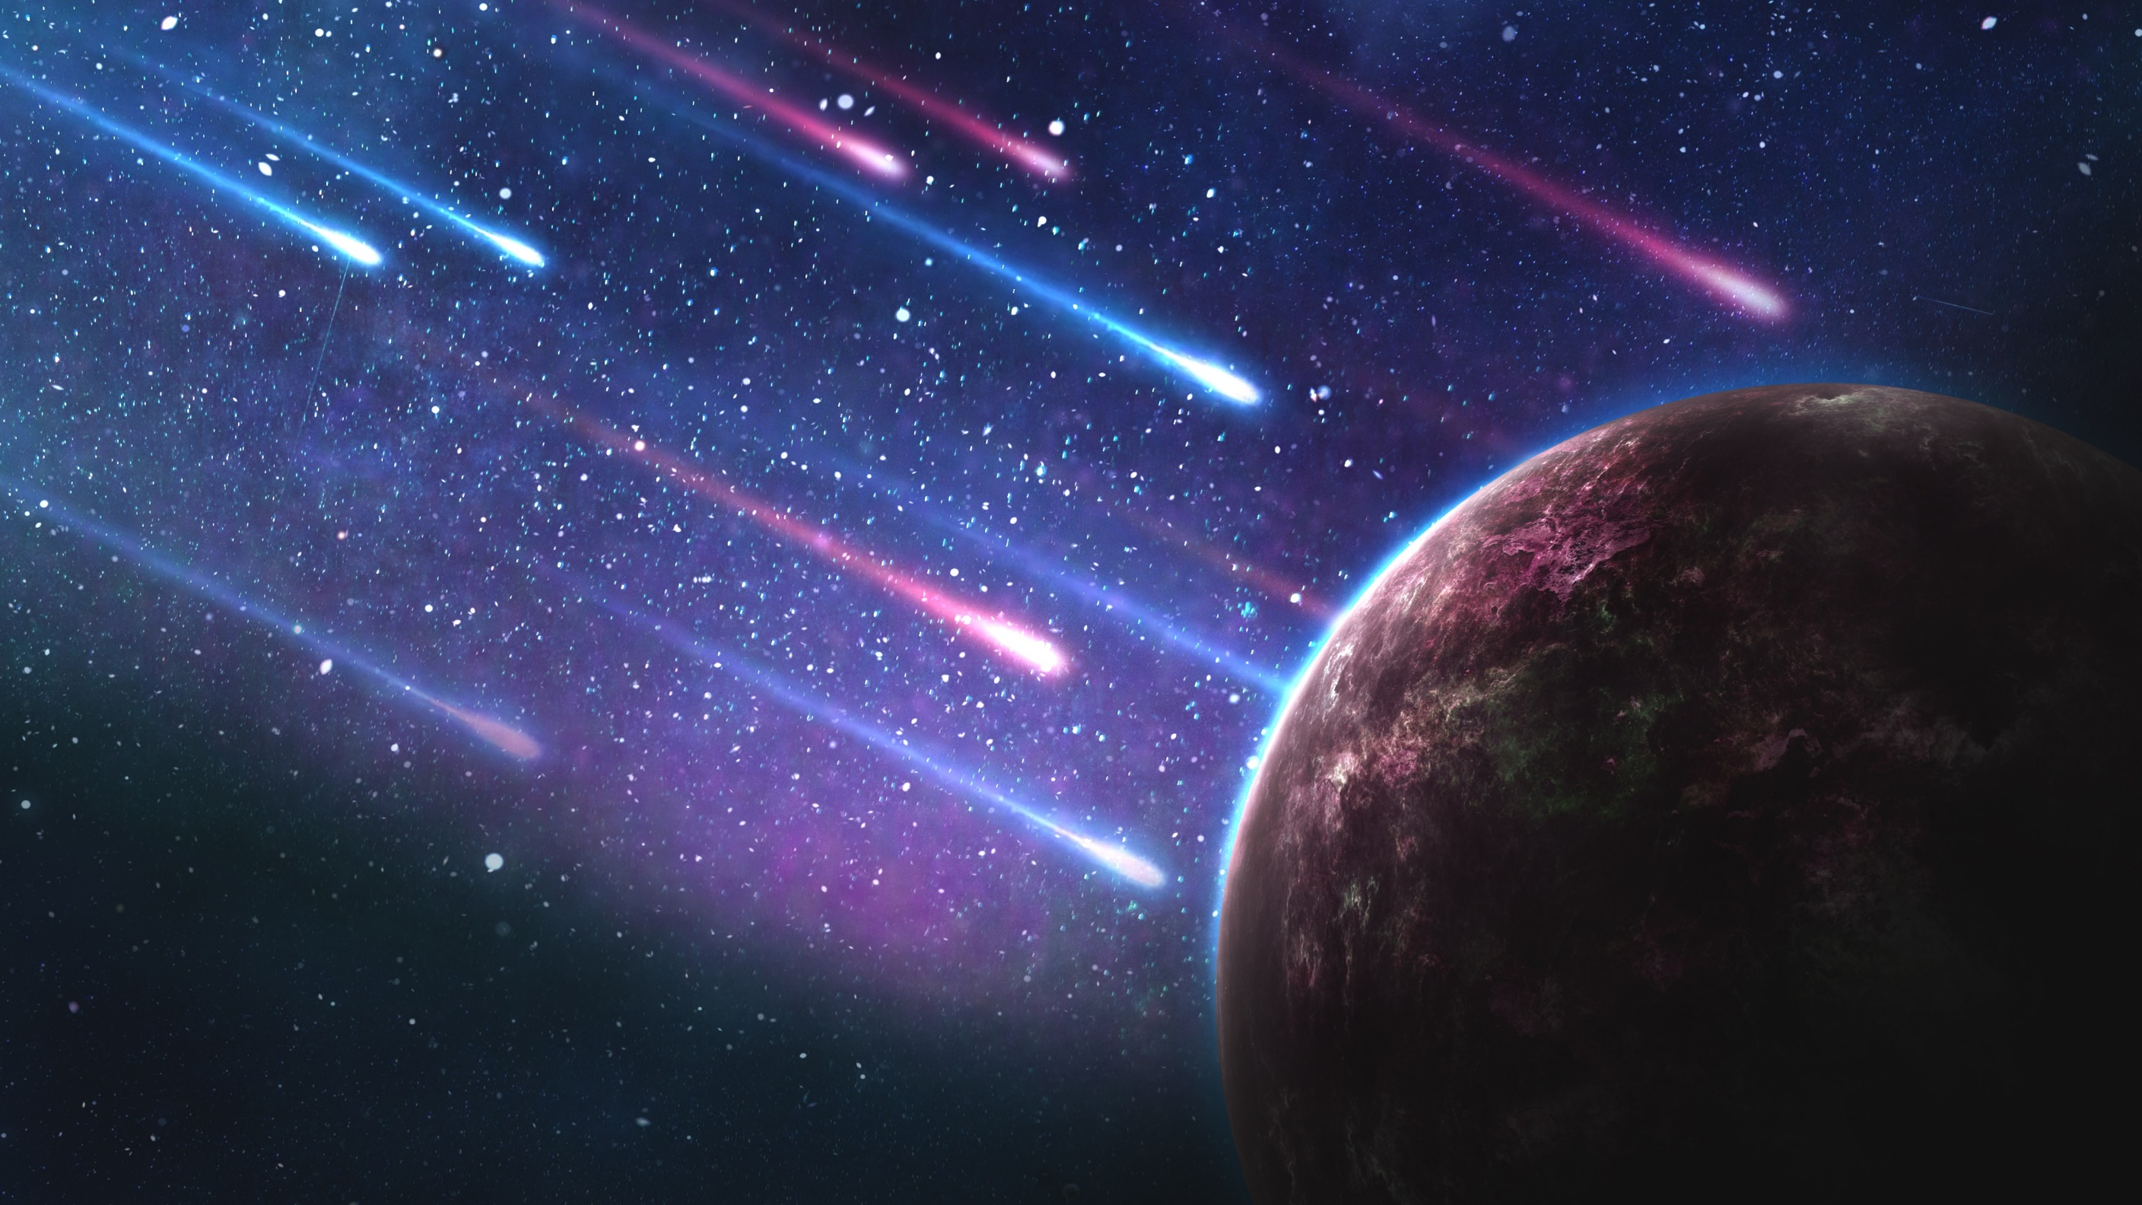
Meteor Shower
HOME

Slide 61
Meteor shower! Meteor shower! Meteor shower! … The sky is falling!
HOME

Slide 62
(Solo) I’m just a grain of dust but I might appear, Just like a streak of fire through the atmosphere. No need to be afraid. I hope that you’re not annoyed. A burning grain of dust, I’m a meteoroid!
HOME

Slide 63
(Solo) Yo! I’m an asteroid. Don’t mean to be rude I’m made of iron and rock, a really cool dude! I circle in an orbit. Yo! I’m just like the earth. Yet I’m too small to be a planet, For whatever it’s worth!
HOME

Slide 64
(Solo) Hey, I’m a comet, just a dirty ball of ice. You just might see me once or you might see me twice. My head is called a nucleus; a coma, my tail. I orbit ‘round the sun and I leave a nice trail.
HOME

Slide 65
Meteor shower! Meteor shower! Meteor shower! … The sky is falling!
HOME

Slide 66
Thunder Part 1
HOME

Slide 67
Do you hear the thunder, thunder, thunder? Does it ever make you wonder What’s going on? Rumbling tumbling, Grumbling all over town.
HOME

Slide 68
Do you hear the thunder, thunder, thunder? Does it ever make you wonder What’s going on? Rumbling tumbling, Grumbling all over town.
HOME

Slide 69
… Climb back under the covers. The noise is keeping me awake!
HOME

Slide 70
Do you hear the thunder, thunder, thunder? Does it ever make you wonder What’s going on? Rumbling tumbling, Grumbling all over town.
HOME

Slide 71
(Spoken) Hear the thunder, thunder! 4 x’s
HOME

Slide 72
… Is it coming or going? The sound has filled me with such fright!
HOME

Slide 73
Do you hear the thunder, thunder, thunder? Does it ever make you wonder What’s going on? Rumbling tumbling, Grumbling all over town.
HOME

Slide 74
Do you hear the thunder, thunder, thunder? 3 x’s
HOME

Slide 75
Thunder Part 2
HOME

Slide 76
Do you hear the thunder, thunder, thunder? Does it ever make you wonder What’s going on? Rumbling tumbling, Grumbling all over town.
HOME

Slide 77
Do you hear the thunder? Do you wonder what’s going on? Rumbling tumbling, Grumbling all over town.
HOME

Slide 78
Close and fasten the shutters. Can’t you feel the whole earth shake? … The noise is keeping me awake!
HOME

Slide 79
Do you hear the thunder? Do you wonder what’s going on? Rumbling tumbling, Grumbling all over town.
HOME

Slide 80
(Spoken) Hear the thunder, thunder! 4 x’s
HOME

Slide 81
Crashing, smashing around us. Will it last throughout the night? … The sound has filled me With such fright!
HOME

Slide 82
Do you hear the thunder? Do you wonder what’s going on? Rumbling, tumbling, Grumbling all over town.
HOME

Slide 83
Do you hear the thunder? 3 x’s
HOME

Slide 84
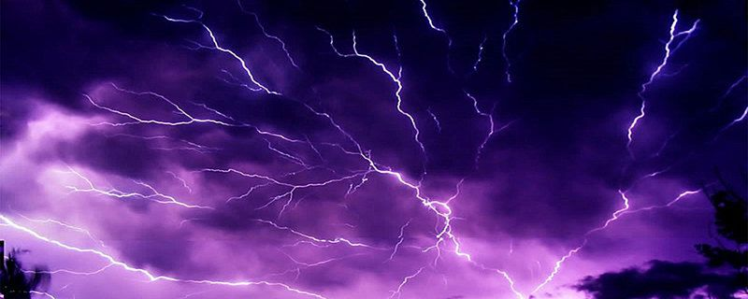
Lightning!
HOME

Slide 85
Electric fingers reaching, reaching. Skipping, darting, fleeting, fleeting.
HOME

Slide 86
Tapping on the clouds, Rapping on their shroud of gray. Lightning, lightning, lightning, lightning! (Lightning), (lightning), (lightning!)
HOME

Slide 87
Now the night is waking, waking. See it sparkling, blinking, (blinking), Sizzling.
HOME

Slide 88
Oh, what a storm of energy, Crackling now, surrounding me! I am not afraid. I am not afraid. Lightning. I am not afraid. Lightning. I am not afraid. Lightning!
HOME

Slide 89
Rolling, rolling, then a flash From cloud to cloud. Sneaking, sneaking to the ground Without a sound.
HOME

Slide 90
Then, then, then, then, Then, then, then, Then, then, then Then, then, then ** BOOM!
HOME

Slide 91
Electric fingers reaching, reaching. Skipping, darting, fleeting, fleeting.
HOME

Slide 92
Tapping on the clouds, Rapping on their shroud of gray. Lightning, lightning, lightning, lightning! (Lightning), (lightning), (lightning!)
HOME

Slide 93
Now the night is waking, waking. See it sparkling, blinking, (blinking), Sizzling.
HOME

Slide 94
Oh, what a storm of energy, Crackling now, surrounding me! I am not afraid. I am not afraid. Lightning. I am not afraid. Lightning. I am not afraid. Lightning!
HOME

Slide 95
Oh, reaching. (Lightning, lightning) Oh, fleeting. (Lightning, lightning) Lightning Lightning Lightning
HOME

Slide 96
Sparkling, blinking, sizzling Now the night is waking Lightning BOOM!
HOME

Slide 97
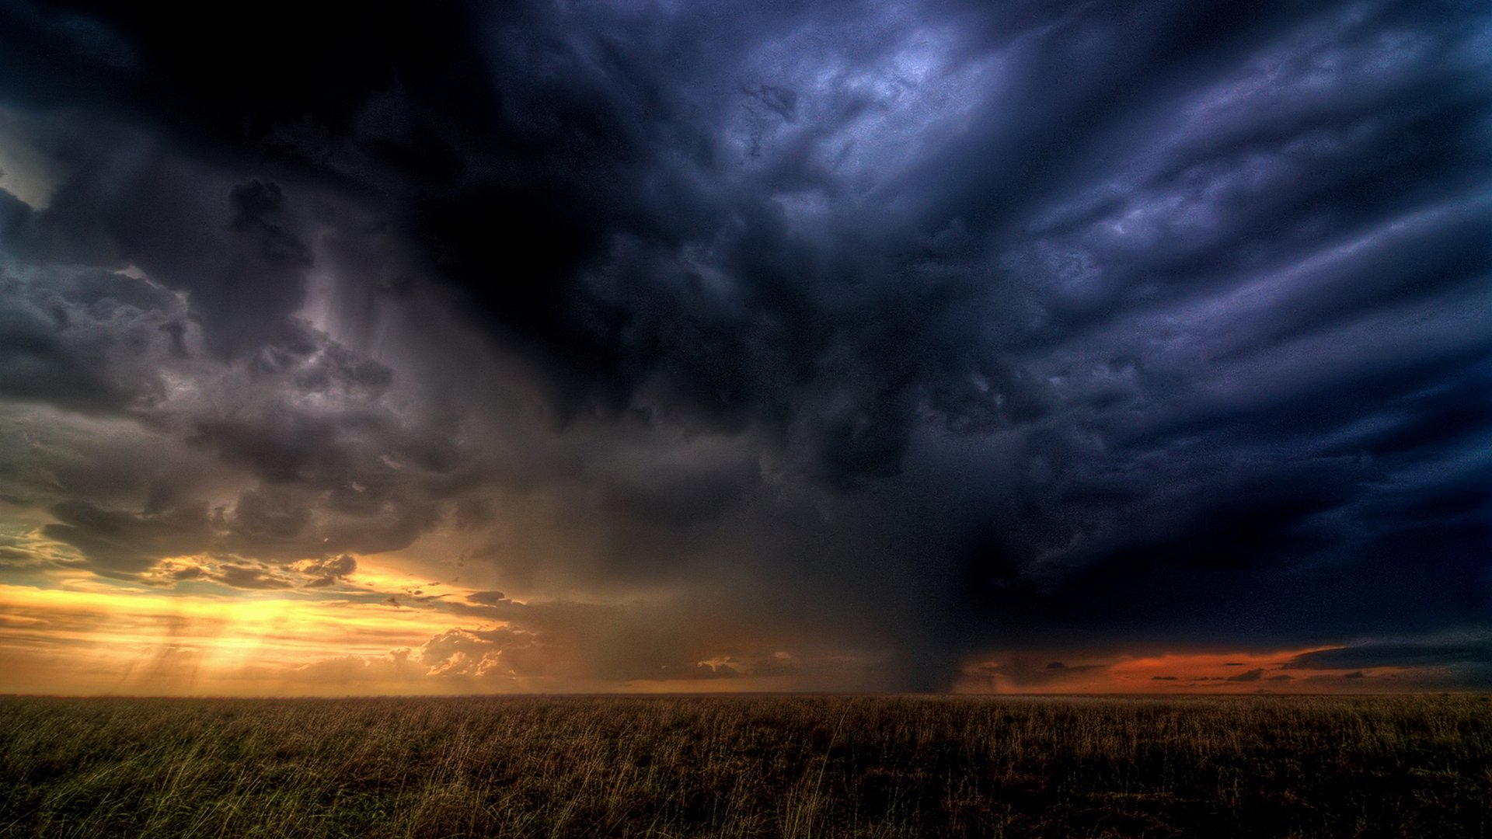
Storm
HOME

Slide 98
(Solo) Hear in the distance a rumbling roar Gathering on the horizon. Towering nimbus preparing to pour Gathering on the horizon.
HOME

Slide 99
Winds blow, shaking the elements, Clouds roll over the sky. Rains flow, washing the earth As the storm rages on the horizon.
HOME

Slide 100
Through the night, flashing in sight, Running and racing, the storm takes flight. Through the night, flashing in sight, Dashing and crashing till morning light.
HOME

Slide 101
Thunder! *** *** *** Lightning! * * * Thunder! *** *** *** Strike with power
HOME

Slide 102
Thunder! *** *** *** Lightning! * * * Thunder! *** *** *** Comes the storm.
HOME

Slide 103
Restless, and relentless Comes the tempest In a galloping furry 4 x’s (6th, add 5th, add 4th, +1 time)
HOME

Slide 104
(Solo) Hear in the distance a rumbling roar Gathering on the horizon. Towering nimbus preparing to pour Gathering on the horizon.
HOME

Slide 105
Winds blow, shaking the elements, Winds blow………………………… Clouds roll over the sky. Clouds roll…………….. Rains flow, washing the earth Rains flow………………….... As the storm rages on the horizon.
HOME

Slide 106
(Round) Through the night, flashing in sight, Running and racing, the storm takes flight. Through the night, flashing in sight, Dashing and crashing till morning light.
HOME

Slide 107
Thunder! *** *** *** Lightning! * * * Thunder! *** *** *** Strike with power
HOME

Slide 108
Thunder! *** *** *** Lightning! * * * Thunder! *** *** *** Comes the storm.
HOME

Slide 109
(Round) Through the night, flashing in sight, Running and racing, the storm takes flight. Through the night, flashing in sight, Dashing and crashing till morning light. Thunder! ****
HOME

Slide 110
Let the Sun Shine Down
HOME

Slide 111
(Solo) May you have enough sun To deep your heart smiling. May you have enough rain So your spirit can grow.
HOME

Slide 112
(Solo) May the storms that you weather Be dim, distant memory. Godspeed wherever you go.
HOME

Slide 113
(Solo) With the wind at your back May you walk to tomorrow. May the sun and the moon Guide your way day and night.
HOME

Slide 114
(Solo) Though the road may get rocky, We look to eternity, Trusting that God shines a light.
HOME

Slide 115
Let the sun shine down. Let the sun shine down. Let the sunshine guide you. Godspeed wherever, wherever you go.
HOME

Slide 116
Let the sun shine down. Let the sun shine down. May your journey find you Trusting that God shines, That God shines a light.
HOME

Slide 117
…
HOME

Slide 118
(Part 2 with solo) Let the sun shine down. Let the sun shine down. Let the sunshine guide you. Godspeed wherever, wherever you go.
HOME

Slide 119
(Part 1+2 with solo) Let the sun shine down. Let the sun shine down. May your journey find you Trusting that God shines, That God shines a light.
HOME

Slide 120
May the path you’ve begun Lead you straight to the One Who will fill up your journey with sun.
HOME

